Slide 1
RED BLACK TREE

Slide 2
What is a Red-Black tree
Red black tree is a form of binary search tree which satisfies following conditions:
Every node is either red or black.
The root node is black.
Every leaf(NIL node) is black
If a node is red, then both of its children(if exists) must be black.
For all the nodes, all simple paths from node to descendant leaves contain same no of black node.

Slide 3
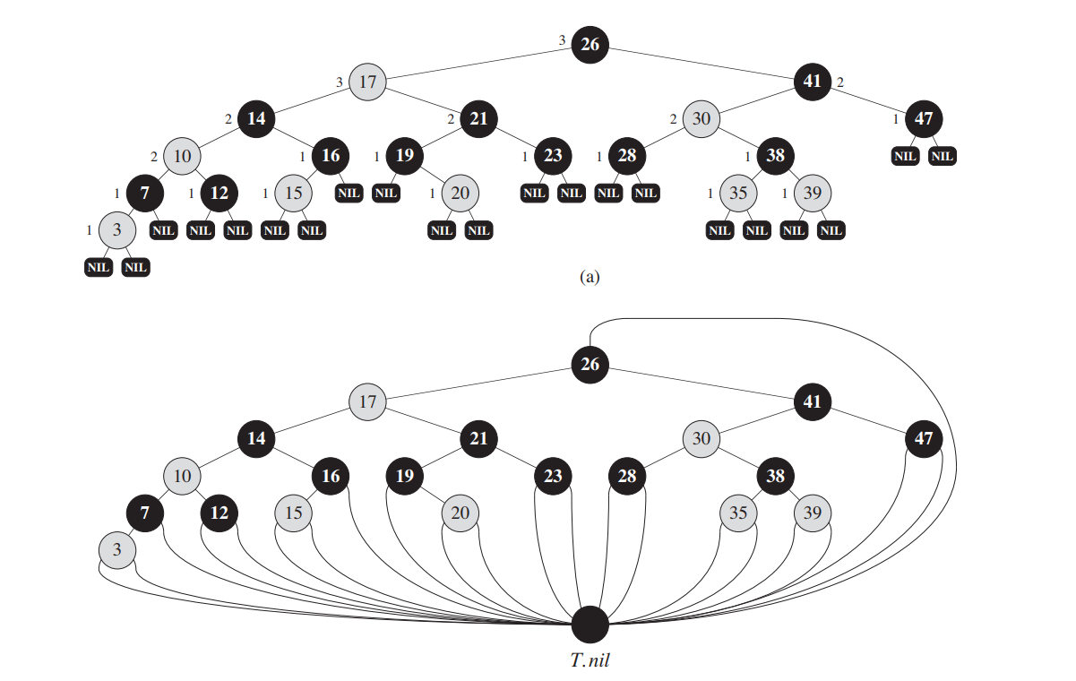
It is better than normal binary search tree as it guarantees complexity of search, insert and delete to be O(log n) in worst case too.
For simplicity of code, all nil nodes are replaced by a sentinel T.nil

Slide 4
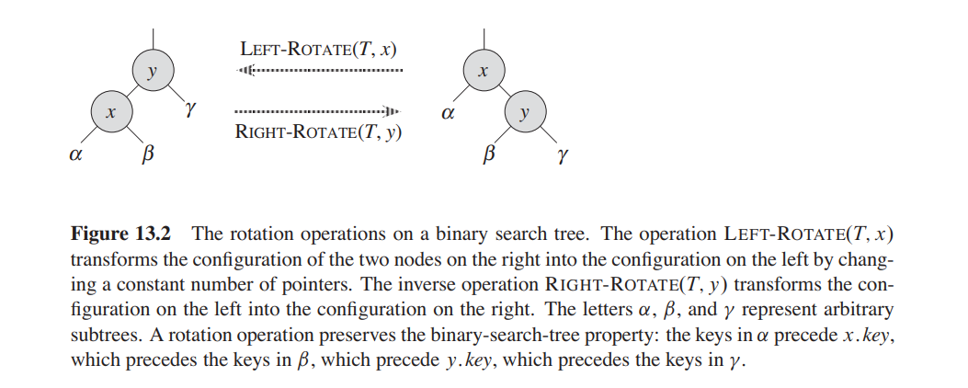
To coordinate the operations of insertion and deletion, we define two other operations as left-rotate and right-rotate as follows:

Slide 5
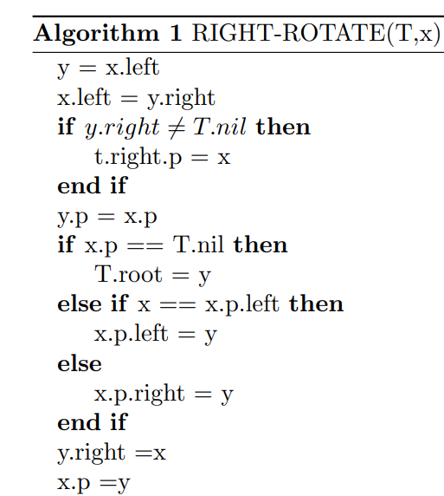
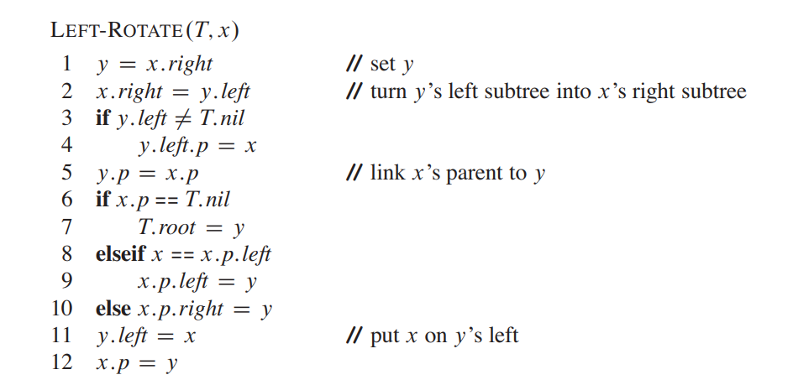
The pseudo codes for left-rotate and right-rotate is given below:

Slide 6
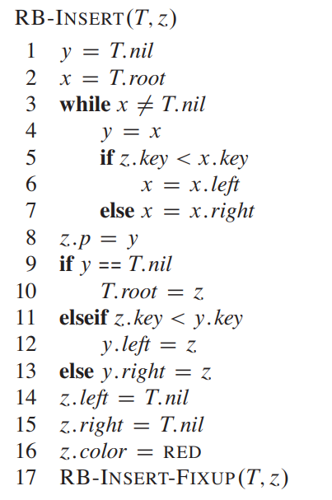
INSERTION
To insert a node into red black tree, we first insert the node at its correct position(which is same as binary search tree i.e. starting from root and going down either left or right depending on value of keys).
We colour the new inserted node as red(line no 16).
But this may cause violation of some of the properties of red-black trees. And to fix it, we call RB-INSERT-FIXUP (Line no 17)

Slide 7
Which properties may be violated?
As we colour new node as red, and if the node to be inserted is the first node(root) then property 2(Refer to slide no 1) will be violated.
If the parent of newly inserted node is red then property 4 will be violated.
The main idea behind insertion is that at most one of the properties 4 and 2 will be violated.
This is because if property 4 violates, then there will be red-red conflict but as we haven’t touched the root the root will be black.
If property 4 doesn’t violate then maybe while bubbling up the newly inserted node(z), and if z becomes the root then it will be red which violates property 4.

Slide 8
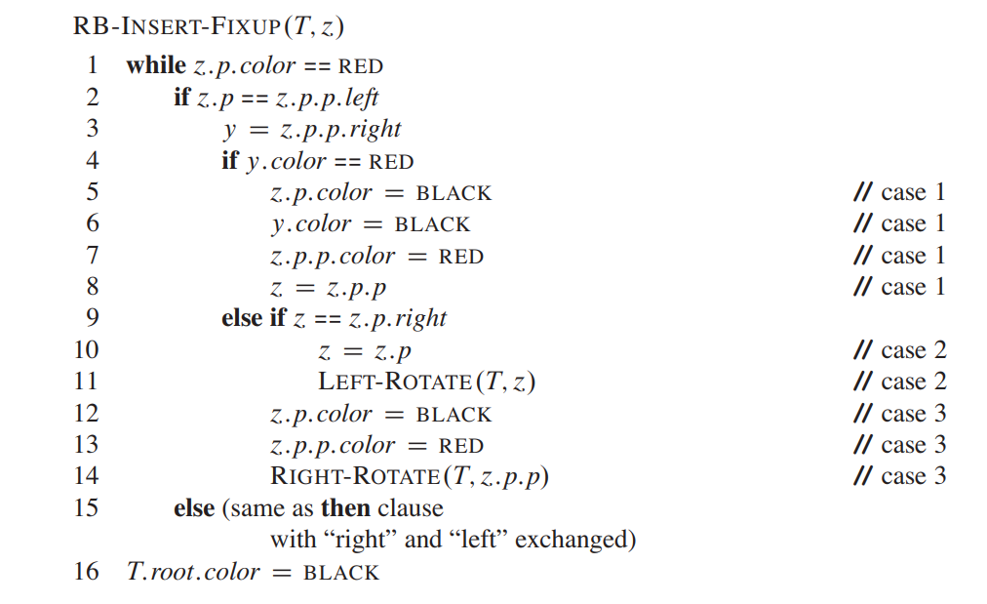

Slide 9
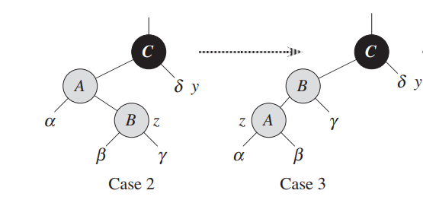
Explanation of RB-INSERT-FIXUP
We divide the analysis into 3 cases:
Z’s uncle, y is red
Z’s uncle, y is black and z is a right child.
Z’s uncle, y is black and z is a left child.
Note that we can convert case 2 into 3 by just performing left-rotation around z.

Slide 10
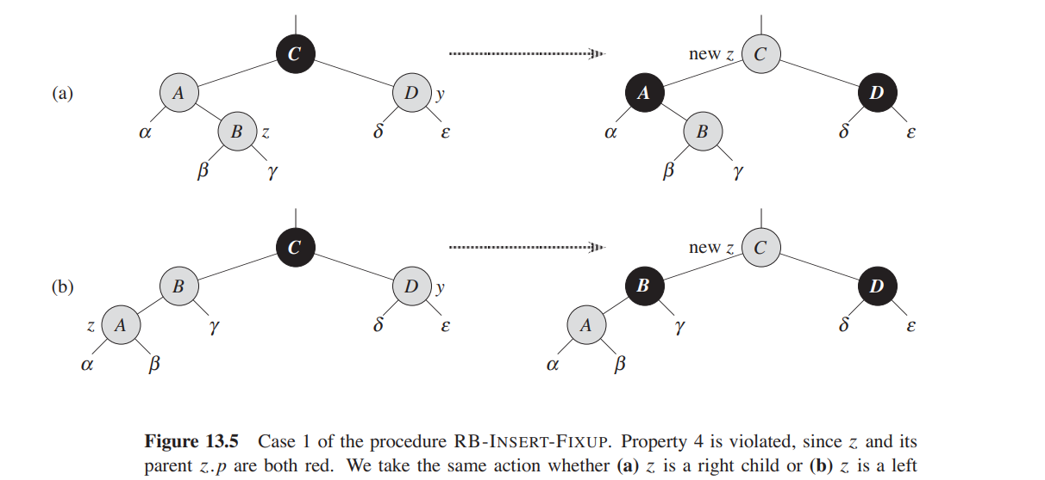
Case 1: z’s uncle y is red
In this case, parent of y should be black(as the remaining tree except z and its parent doesn’t violate property 4)
So, we just bubble up z colouring z.parent and y as black and y.parent as red. Here property 5 isn’t violated as we are colouring both y and z.parent as black so black-height of y.parent remains same.
But now z is pointed to z’s grandparent which may be root and as we colour z as red, property 2 is violated. Hence to take care of this, line 16 colours root as black.

Slide 11
Case 2 and 3: z’s uncle is black.
If case 2 arrives, we do a left rotation immediately (lines 10,11) to convert it into case 3.
the node z.p.p exists, since we have argued that this node existed at the time that lines 2 and 3 were executed, and after moving up one level in line 10 and then down one level in line 11, the identity of z.p.p remains unchanged. In case 3, we execute some color changes and a right rotation, which preserve property 5, and then, since we no longer have two red nodes in a row, we are done. The while loop does not iterate another time, since z.p is now black.

Slide 12
Time complexity of insertion:
As the loop continues till z.parent is red and every time z is moved 2 level up until z’s uncle is red so no of iterations is upper bounded by height of the tree. Hence the time complexity in O(log n)

Slide 13
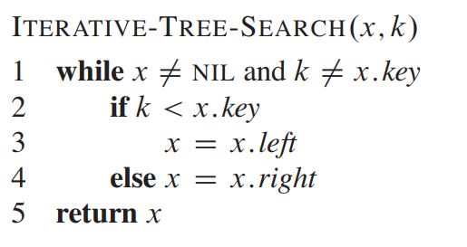
SEARCH IN RED-BLACK-TREE
The search in red-black tree is same as search in normal binary-search tree where we start from root and traverse down comparing the key to be searched and current node’s key.

Slide 14
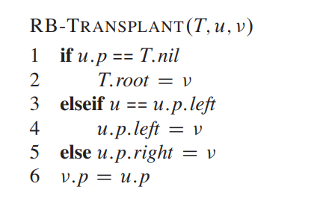
DELETION
To accompany deletion we first introduce a helper function RB-TRANSPLANT which moves the subtrees.
The responsibility of setting v.left and v.right solely depends on caller.
When we want to delete node z and z has fewer than two children, then z is removed from the tree, and we want y to be z. When z has two children, then y should be z’s successor, and y moves into z’s position in the tree. We also remember y’s color before it is removed from or moved within the tree, and we keep track of the node x that moves into y’s original position in the tree, because node x might also cause violations of the red-black properties. After deleting node z, RB-DELETE calls an auxiliary procedure RB-DELETE-FIXUP, which changes colors and performs rotations to restore the red-black

Slide 15
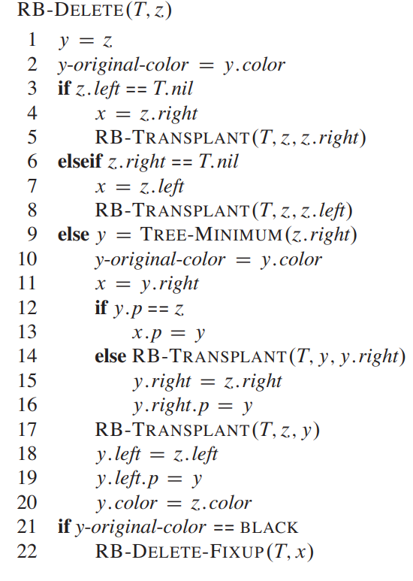

Slide 16
Which properties may be violated?
Notice that if y was red, the red-black properties still hold when y is removed or moved because:
No black heights in the trees have been changed
No red nodes have been made adjacent
Since y could not have been the root if it was red, the root remains black.
While on the other side, if y was black 3 problems may arise:
If y had been the root and a red child of y becomes the new root, we have violated property 2.
If both x and x.p are red, then we have violated property 4.
Moving y within the tree causes any simple path that previously contained y to have one fewer black node. Thus, property 5 is now violated by any ancestor of y in the tree.

Slide 17
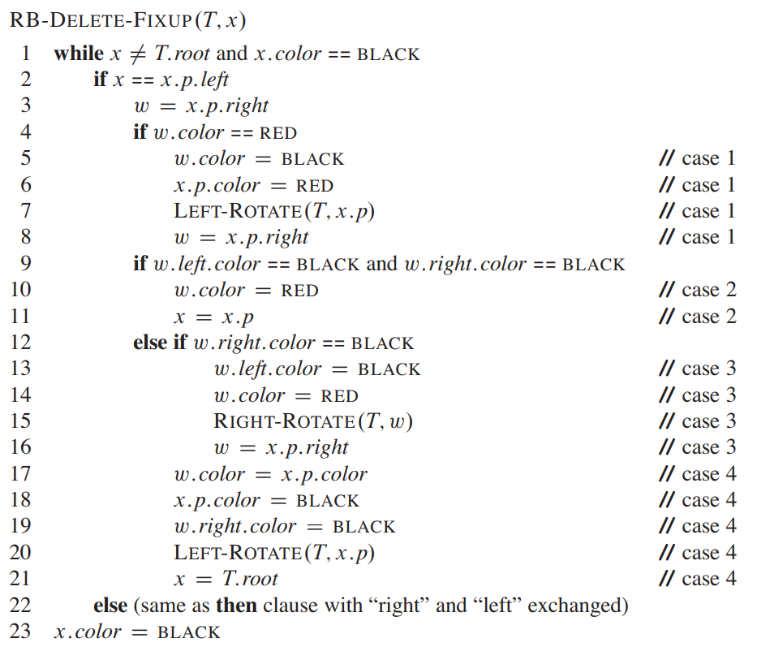

Slide 18
RB-DELETE-FIXUP
It restores property 1,2 and 4. The goal of the while loop in lines 1–22 is to move the extra black up the tree until:
x points to a red-and-black node, in which case we color x (singly) black in line 23
x points to the root, in which case we simply “remove” the extra black;
having performed suitable rotations and recolourings, we exit the loop.
Within the while loop, x always points to a nonroot doubly black node.

Slide 19
Cases to be analysed
Case 1: x’s sibling w is red
Case 2: x’s sibling w is black, and both of w’s children are black
Case 3: x’s sibling w is black, w’s left child is red, and w’s right child is black
Case 4: x’s sibling w is black, and w’s right child is red
Before examining each case in detail, let’s look more generally at how we can verify that the transformation in each of the cases preserves property 5. The key idea is that in each case, the transformation applied preserves the number of black nodes (including x’s extra black) from (and including) the root of the subtree shown to each of the subtrees α,β,..,ζ

Slide 20
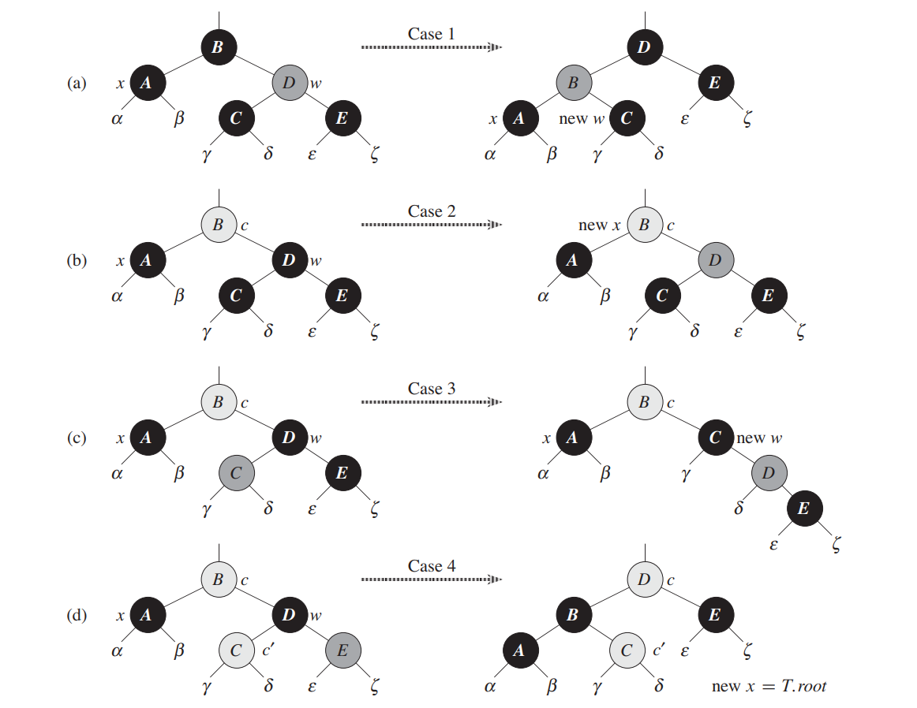

Slide 21
Case 1: x’s sibling w is red
Case 1 (lines 5–8 of RB-DELETE-FIXUP and Figure 13.7(a)) occurs when node w, the sibling of node x, is red. Since w must have black children, we can switch the colors of w and x.p and then perform a left-rotation on x.p without violating any of the red-black properties. The new sibling of x, which is one of w’s children prior to the rotation, is now black, and thus we have converted case 1 into case 2, 3, or 4. Cases 2, 3, and 4 occur when node w is black; they are distinguished by the colors of w’s children

Slide 22
CASE 2 : x’s sibling w is black, and both of w’s children are black
In case 2 (lines 10–11 of RB-DELETE-FIXUP and Figure 13.7(b)), both of w’s children are black. Since w is also black, we take one black off both x and w, leaving x with only one black and leaving w red. To compensate for removing one black from x and w, we would like to add an extra black to x:p, which was originally either red or black. We do so by repeating the while loop with x.p as the new node x. Observe that if we enter case 2 through case 1, the new node x is red-and-black, since the original x:p was red. Hence, the value c of the color attribute of the new node x is RED, and the loop terminates when it tests the loop condition. We then color the new node x (singly) black in line 23.

Slide 23
Case 3:: x’s sibling w is black, w’s left child is red, and w’s right child is black
Case 3 (lines 13–16 and Figure 13.7(c)) occurs when w is black, its left child is red, and its right child is black. We can switch the colors of w and its left child w.left and then perform a right rotation on w without violating any of the red-black properties. The new sibling w of x is now a black node with a red right child, and thus we have transformed case 3 into case 4.

Slide 24
Case 4: x’s sibling w is black, and w’s right child is red
Case 4 (lines 17–21 and Figure 13.7(d)) occurs when node x’s sibling w is black and w’s right child is red. By making some color changes and performing a left rotation on x:p, we can remove the extra black on x, making it singly black, without violating any of the red-black properties. Setting x to be the root causes the while loop to terminate when it tests the loop condition

Slide 25
Complexity of Delete:
Since the height of a red-black tree of n nodes is O.(log n), the total cost of the procedure without the call to RB-DELETEFIXUP takes O(log n)time. Within RB-DELETE-FIXUP, each of cases 1, 3, and 4 lead to termination after performing a constant number of color changes and at most three rotations. Case 2 is the only case in which the while loop can be repeated, and then the pointer x moves up the tree at most O(log n) times, performing no rotations. Thus, the procedure RB-DELETE-FIXUP takes O(log n) time and performs at most three rotations, and the overall time for RB-DELETE is therefore also O(log n)

